Slide 1
Overview of Reading Workshop for Parents
Fall 2015
Notes:
This year we are embarking on a new method of teaching reading with the goal of emphasizing reading skills and strategies that your child needs to grow as a reader. In the past we have emphasized the content of the texts this year students will be reading different texts that are at their level and the teaching will emphasize the skills or strategies that he/she needs as a reader.

Slide 2
What is Reading Workshop?
A teaching method with the goal of explicitly teaching strategies to skillfully comprehend text
Emphasis is on the skills & strategies you need as a reader – not the content of the book
Students read authentic texts that focus on strengths and needs of individual students as readers
Emphasizes the importance of student engagement and interactions between readers and text
Notes:
Readers workshop is new to all of us so we will be learning together. We will follow the Teacher’s College Reading and Writing Project’s philosophy

Slide 3
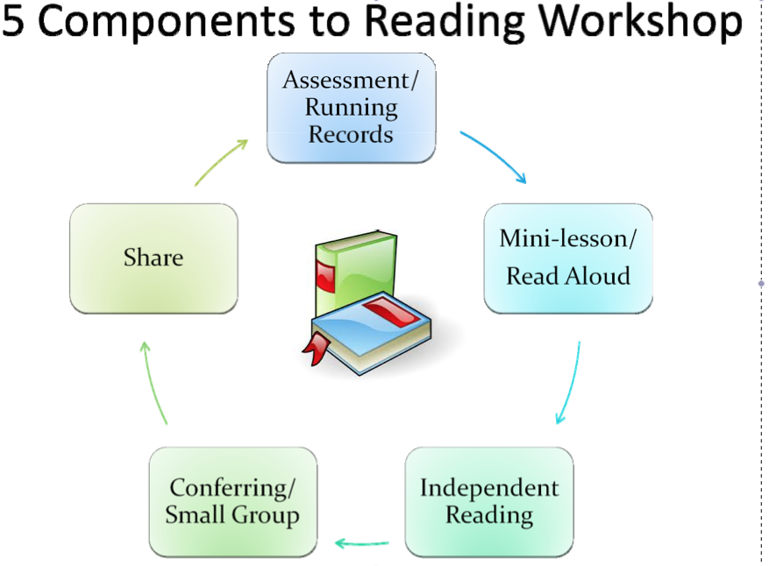
Notes:
Readers workshop relies heavily on knowing where your students are as a reader so assessments play an important role. We use the Fountas and Pinnell BAS to read with your child and learn a level of text that they can read best on their own- this is the just right level that they will read during independent reading, we also want to know the instructional level of text so we can teach them at the right level to move up and grow as a reader…
Everyday we will start with a short mini-lesson that is only about 10 minutes long to teach a specific skill or strategy that the student need to know
Then every day children will read independently at their just right level to practice the skills and strategies being taught
While students are reading I will pull a small group or two to teach guided reading and also confer with readers where I get the chance to sit with a student 1:1 and better understand how they are doing as a reader to determine what they need to be taught – this allows for immediate differentiation so I can stretch high achieving readers or help to reteach a skill for a struggling reader.
There is also an opportunity for students to share with each other what they are learning and to reflect on the work the class is doing as readers…

Slide 4
Why?
Provides students daily opportunities to read books/ materials that they choose (with teacher assistance).
Allows for differentiated instruction –meeting students where they are and taking them as far as they can go.
The structure ensures that teachers have time to meet the needs of each student in his or her classroom- whole group, small group and 1:1 conferring.
Time is spent discussing books and creating a community of readers to support a life long love of books.
CT Core Standards and 21st Century Learning requires that student read more complex texts with understanding. This structure values critical thinking, talking and writing about complex texts.
Notes:
Students will read a lot, and they will have choice in what they read… for example if we are in a MYSTERY unit of study they can choose a mystery at their just right level
Students will all be taken from where they are as a reader and grow
We will read, write and talk about books every day
This method is fully aligned with the expectations of the CT Core Standards and will help our students achieve at high levels.

Slide 5
How Can you Help?
Support reading at home. Your child should read every night! Often the same book at home and school.
Understand that levels matter- JUST RIGHT! Interest, motivation, comprehension and individual progress is valued for every child.
Talk with your child about what they are reading. Share what you are reading with him/her.
Ask questions.
Notes:
Grades K-1Your child will bring home a bag of books, some are familiar and he/she can read and reread others your child may be interested in and you can read it to them! At this age a passion for books and sharing and talking about books is very important. We are teaching your child important routines that will help them grow as a reader.
Grades 2-4 It may be new for your child to read the same book at home and school but something we have learned is that students need to keep up an appropriate pace to complete books and move to a new book. The amount of reading your child does has a direct impact on their success in school and on standardized tests. (Share chart with pace of finishing a book)
We do not want to over emphasize the specific level your child is reading we do however want to ensure that there is an appropriate match between your child and the text so that they can get the most out of it. I am happy to help with this… sometimes your child may want to read a book that is just too hard at this point… or a book that is the right level but the content is too mature, or a book that is just too easy and won’t stretch them.. A JUST RIGHT match is critical and something that we will work on together.
Reading is social – as much as possible talk with your child about what they are reading, ask them for recommendations, let them know what you are reading… reading should be fun!
Please reach out with any questions you may have.

